Slide 1

Residuals, $R^{2}$, S
- Lesson 3.3 -

Slide 2
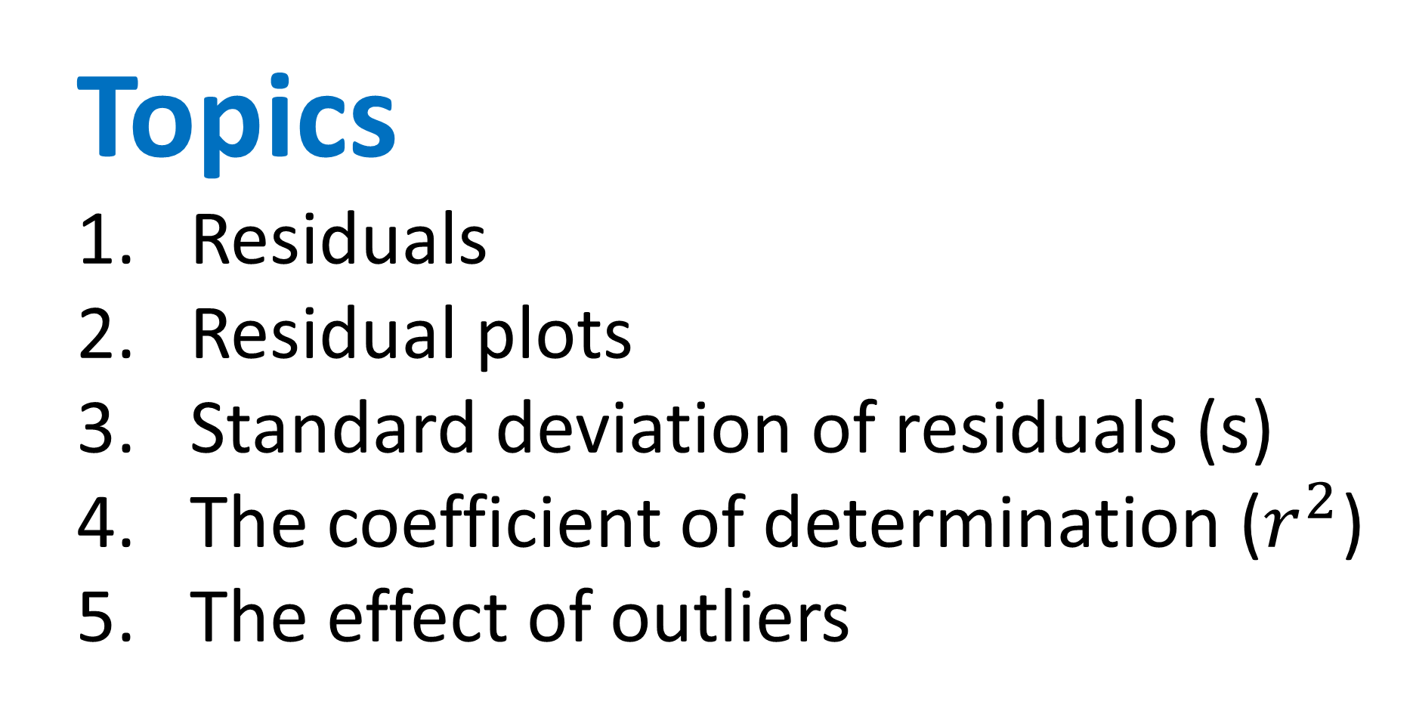
Topics
Residuals
Residual plots
Standard deviation of residuals (s)
The coefficient of determination ($r^{2}$)
The effect of outliers

Slide 3
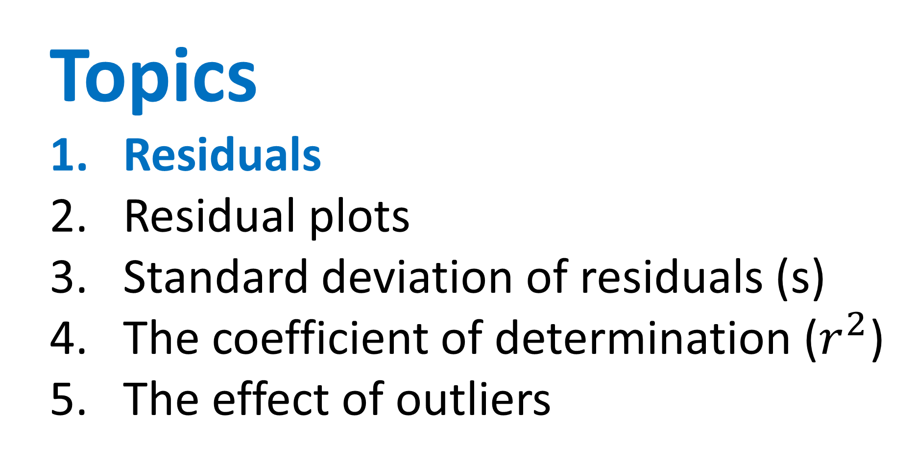
Topics
Residuals
Residual plots
Standard deviation of residuals (s)
The coefficient of determination ($r^{2}$)
The effect of outliers

Slide 4
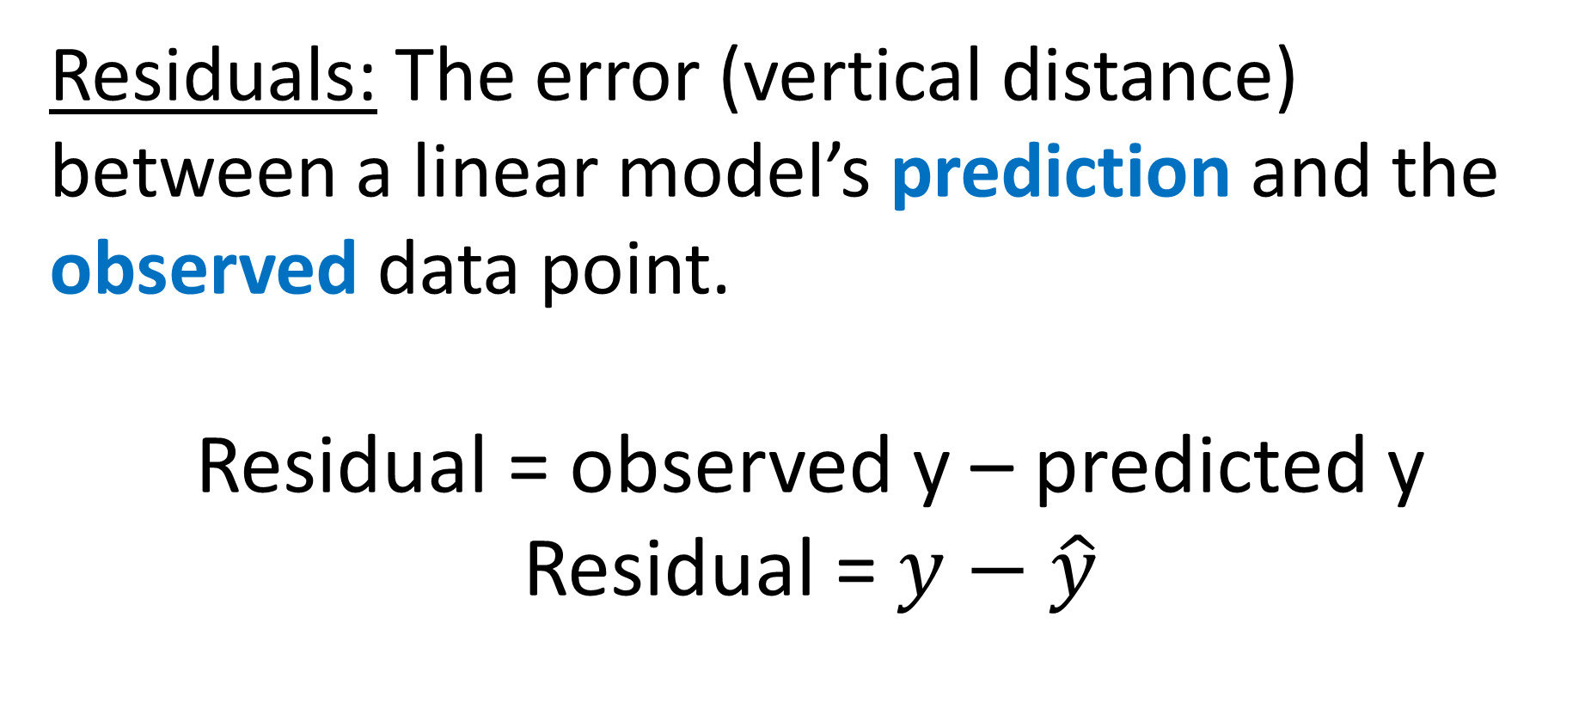
Residuals
Residuals: The error (vertical distance) between a linear model’s prediction and the observed data point.
Residual = observed y – predicted y
Residual = $y−\hat{y}$

Slide 5
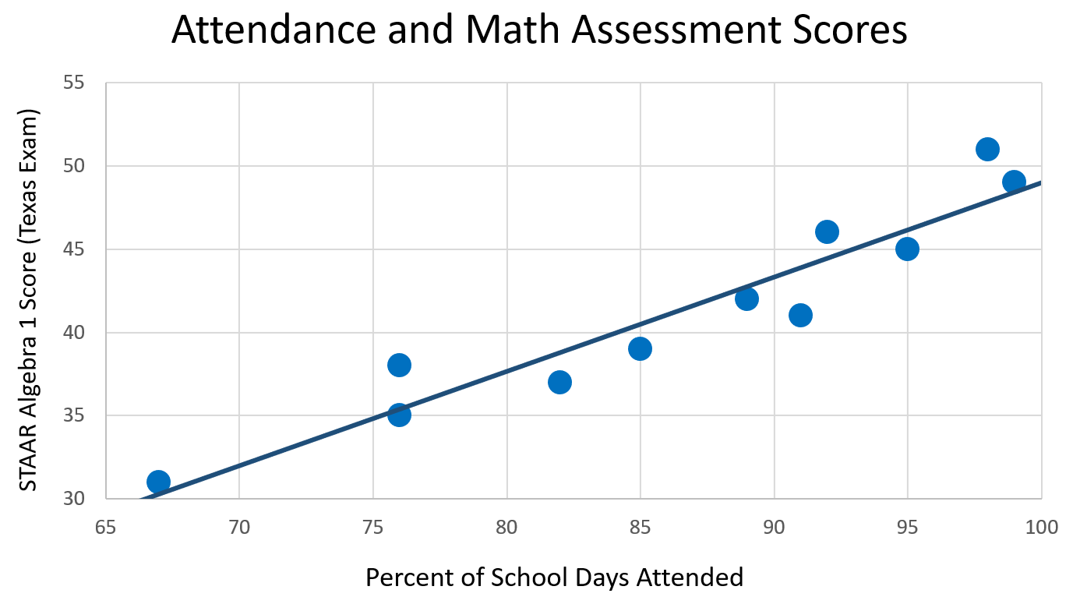

Slide 6

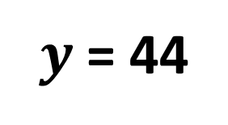
The student gets 44 questions correct on his exam. Find and interpret our model’s prediction error (residual) for this student.
$y$ = 44
6.09
$\hat{y}$ = 37.91

Slide 7
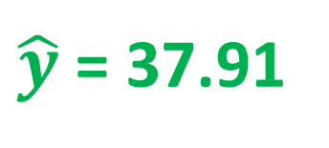
The actual test score is greater than predicted by 6.09 points.
$y$ = 44
6.09
$\hat{y}$ = 37.91

Slide 8
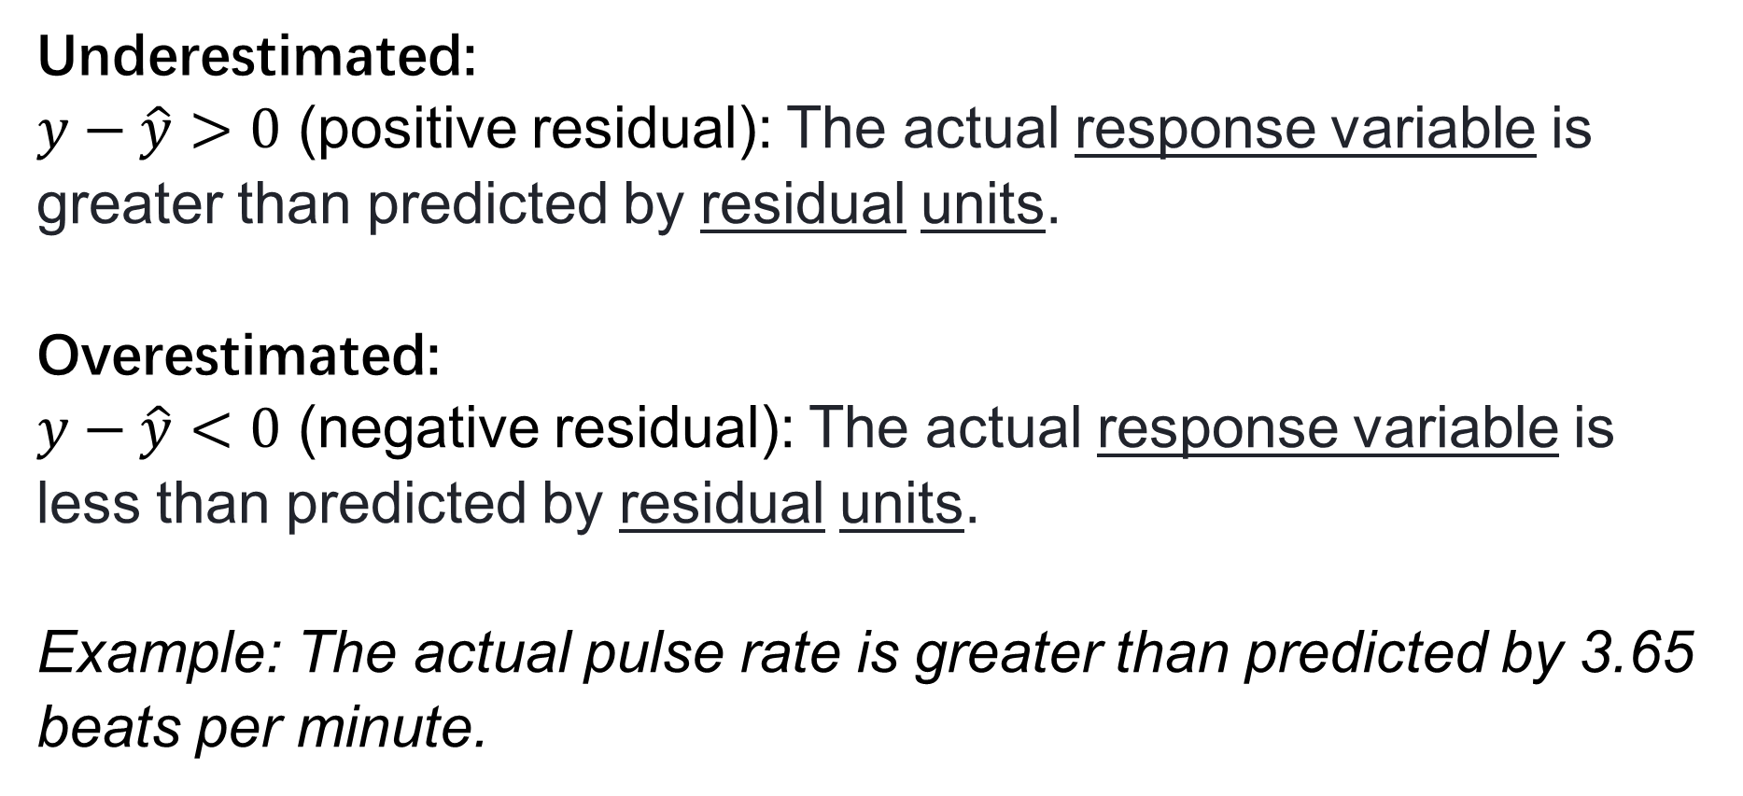
Template
Underestimated:
$y−\hat{y}>0$ (positive residual): The actual response variable is greater than predicted by residual units.
Overestimated:
$y−\hat{y}<0$ (negative residual): The actual response variable is less than predicted by residual units.
Example: The actual pulse rate is greater than predicted by 3.65 beats per minute.

Slide 9
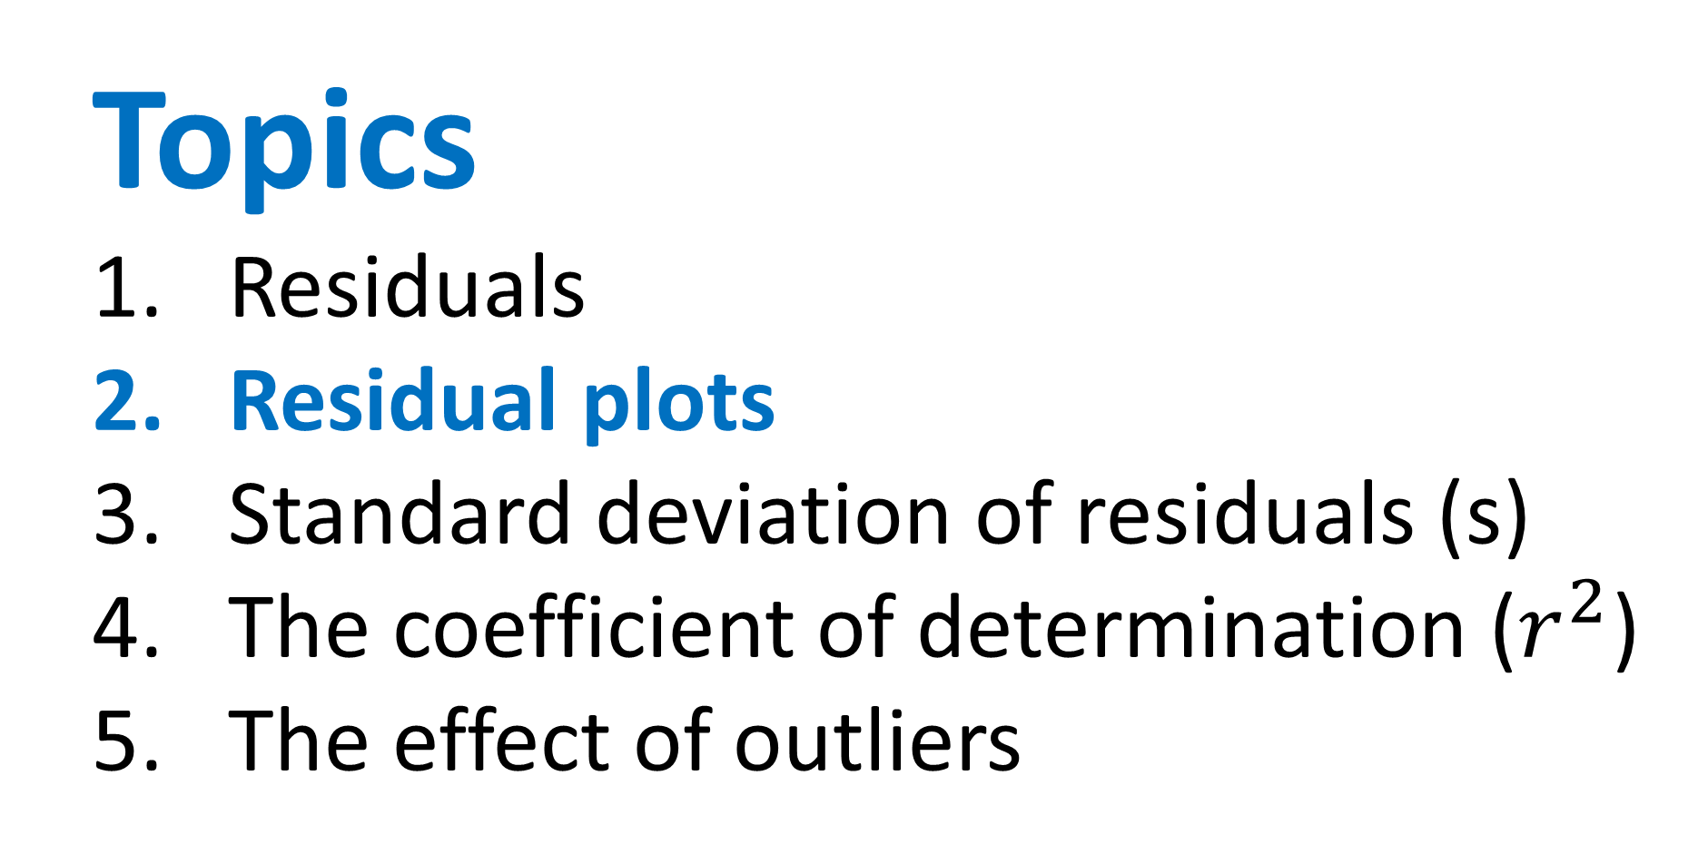
Topics
Residuals
Residual plots
Standard deviation of residuals (s)
The coefficient of determination ($r^{2}$)
The effect of outliers

Slide 10

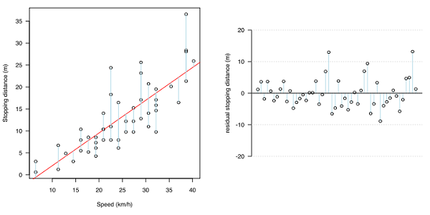
Residual Plots
It allows us to see if there is a pattern within the data that we perhaps could not see on the scatterplot.
If there is no pattern in the residual plot, it means the line captures the overall pattern of the data and that a line is an appropriate model for the data.

Slide 11

Residual Plots – Good Fit
apparent randomness
centered at 0
no obvious pattern
Residuals randomly scattered around 0, without a pattern → linear model is a good fit for this data!

Slide 12
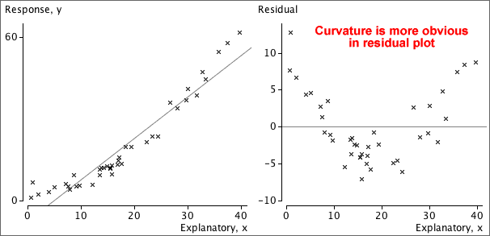
Residual Plots – Non-Linear

Slide 13
Residual Plots – Non-Linear

Slide 14
Residual Plots – Non-Linear
Residuals show a curved pattern→ linear model is not a good fit for this data!

Slide 15
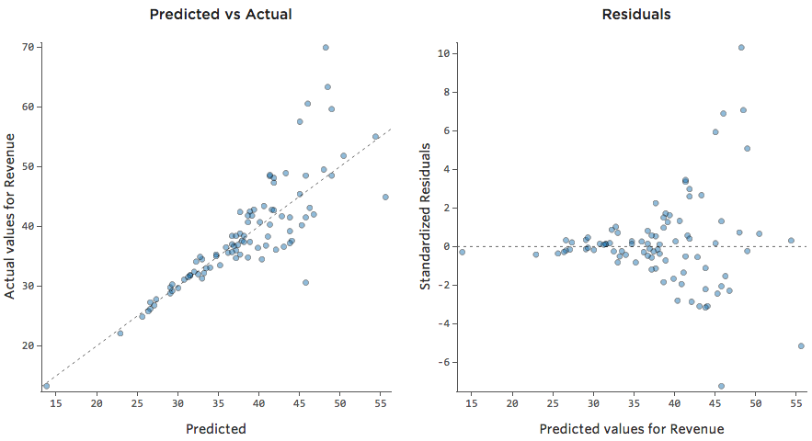
Residual Plots – Heteroskedastic

Slide 16
Residual Plots – Heteroskedastic
x

Slide 17
Residual Plots – Heteroskedastic
x

Slide 18
Residual Plots – Heteroskedastic
x

Slide 19
Residual Plots – Heteroskedastic
x
More variation in residuals as x values increase → linear model is not a good fit for this data!

Slide 20
Residual Plots – Heteroskedastic
Heteroskedasticity
x
More variation in residuals as x values increase → linear model is not a good fit for this data!

Slide 21
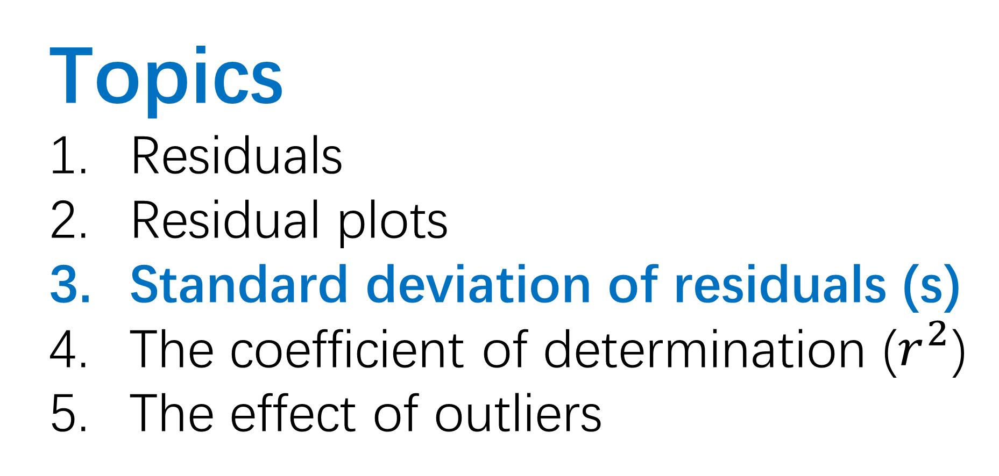
Topics
Residuals
Residual plots
Standard deviation of residuals (s)
The coefficient of determination ($r^{2}$)
The effect of outliers

Slide 22
Standard deviation of the residuals (s)
Standard deviation: Typical distance between data points and the mean
Standard deviation of the residuals (s): Typical error between data points and the LSRL (typical residual length)

Slide 23
Stdev. of the residuals (s)
A
B

Slide 24
Stdev. of the residuals (s)
A
← Stronger relationship between x & y
Exactly how much stronger is the relationship?
B

Slide 25
Stdev. of the residuals (s)
A
s:
Stronger correlation
Smaller s
B
s:
Weaker correlation
Larger s

Slide 26
1) The standard deviation of the residuals for the LSRL between attendance and test scores is s = 1.99.
Interpret this value.

Slide 27
1) The standard deviation of the residuals for the LSRL between attendance and test scores is s = 1.99.
Interpret this value.
When using the LSRL with explanatory variable to predict response variable, we will typically be off by about value of s with units of the response variable (y).

Slide 28
1) The standard deviation of the residuals for the LSRL between attendance and test scores is s = 1.99.
Interpret this value.
When using the LSRL with explanatory variable to predict response variable, we will typically be off by about value of s with units of the response variable (y).
When using the LSRL with attendance to predict test scores, we will typically be off by about 1.99 points.

Slide 29
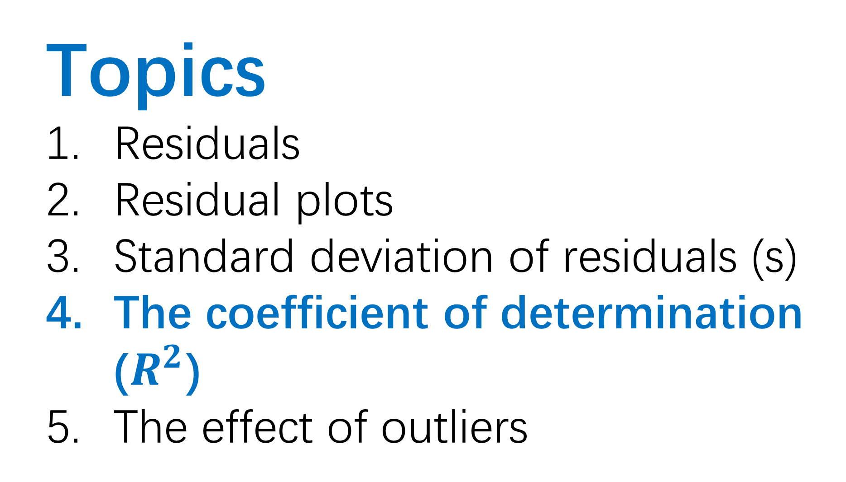
Topics
Residuals
Residual plots
Standard deviation of residuals (s)
The coefficient of determination ($R^{2}$)
The effect of outliers

Slide 30
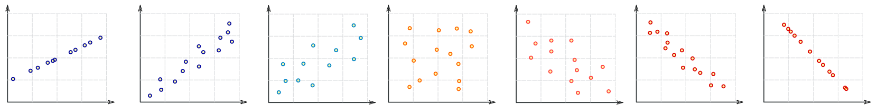
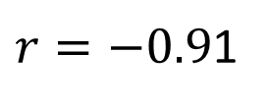




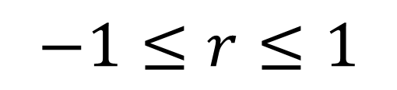


Correlation Coefficient (r)
Graphic inspired by mathisfun.com
Perfect Positive Correlation
Strong Positive Correlation
Weak Positive Correlation
Weak Negative Correlation
Strong Negative Correlation
Perfect Negative Correlation
No
Correlation
$$r=1$$
$$r=0.91$$
$$r=0.48$$
$$r=0$$
$$r=−0.48$$
$r=−0.9$1
$$r=−1$$
$$−1≤r≤1$$

Slide 31

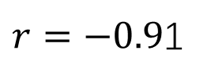

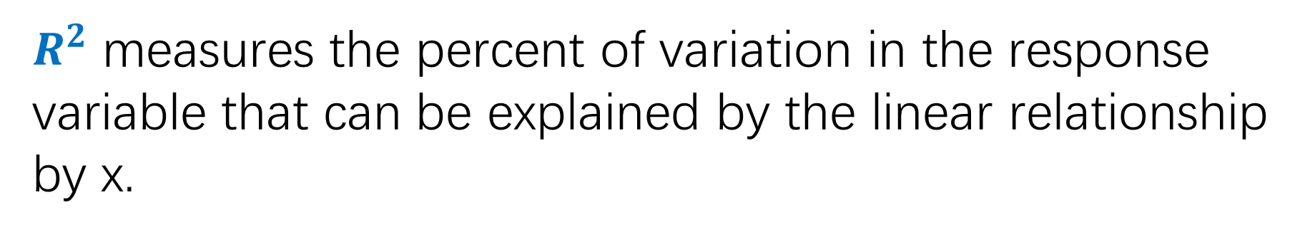













Coefficient of determination (R²)
Perfect Positive Correlation
Strong Positive Correlation
Weak Positive Correlation
Weak Negative Correlation
Strong Negative Correlation
Perfect Negative Correlation
No
Correlation
$$r=1$$
$$r=0.91$$
$$r=0.48$$
$$r=0$$
$$r=−0.48$$
$r=−0.9$1
$$r=−1$$
$$R^{2}=1$$
$$R^{2}=0.83$$
$$R^{2}=0.23$$
$$R^{2}=0$$
$$R^{2}=0.23$$
$$R^{2}=0.83$$
$$R^{2}=1$$
$$0≤R^{2}≤1$$
$R^{2}$ measures the percent of variation in the response variable that can be explained by the linear relationship by x.

Slide 32
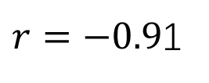














Coefficient of determination (R²)
Perfect Positive Correlation
Strong Positive Correlation
Weak Positive Correlation
Weak Negative Correlation
Strong Negative Correlation
Perfect Negative Correlation
No
Correlation
$$r=1$$
$$r=0.91$$
$$r=0.48$$
$$r=0$$
$$r=−0.48$$
$r=−0.9$1
$$r=−1$$
$$R^{2}=1$$
$$R^{2}=0.83$$
$$R^{2}=0.23$$
$$R^{2}=0$$
$$R^{2}=0.23$$
$$R^{2}=0.83$$
$$R^{2}=1$$
$$0≤R^{2}≤1$$
Squaring the values:
1) Gets rid of negatives
2) Emphasizes differences in strength

Slide 33
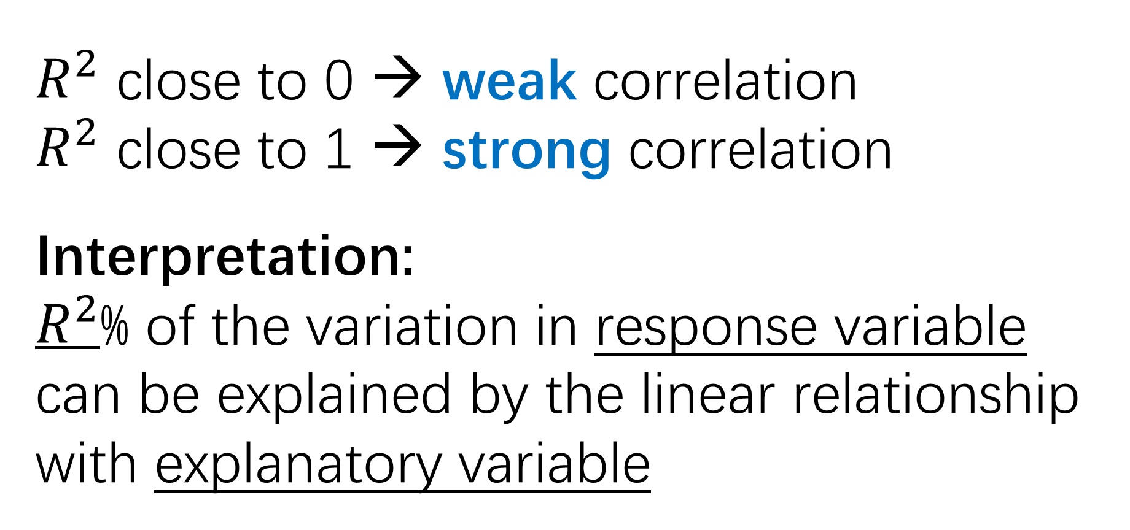
$R^{2}$ close to 0 → weak correlation
$R^{2}$ close to 1 → strong correlation
Interpretation:
$R^{2}$% of the variation in response variable can be explained by the linear relationship with explanatory variable

Slide 34
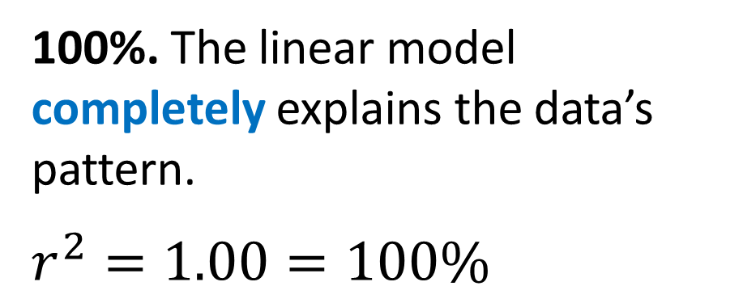
What percent of the data’s pattern can be explained by a linear model?
100%. The linear model completely explains the data’s pattern.
$$r^{2}=1.00=100\%$$

Slide 35
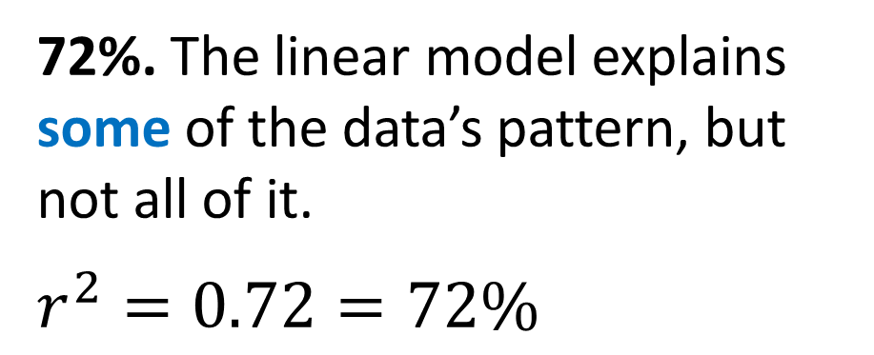
What percent of the data’s pattern can be explained by a linear model?
100%. The linear model completely explains the data’s pattern.
$$r^{2}=1.00=100\%$$
72%. The linear model explains some of the data’s pattern, but not all of it.
$$r^{2}=0.72=72\%$$

Slide 36
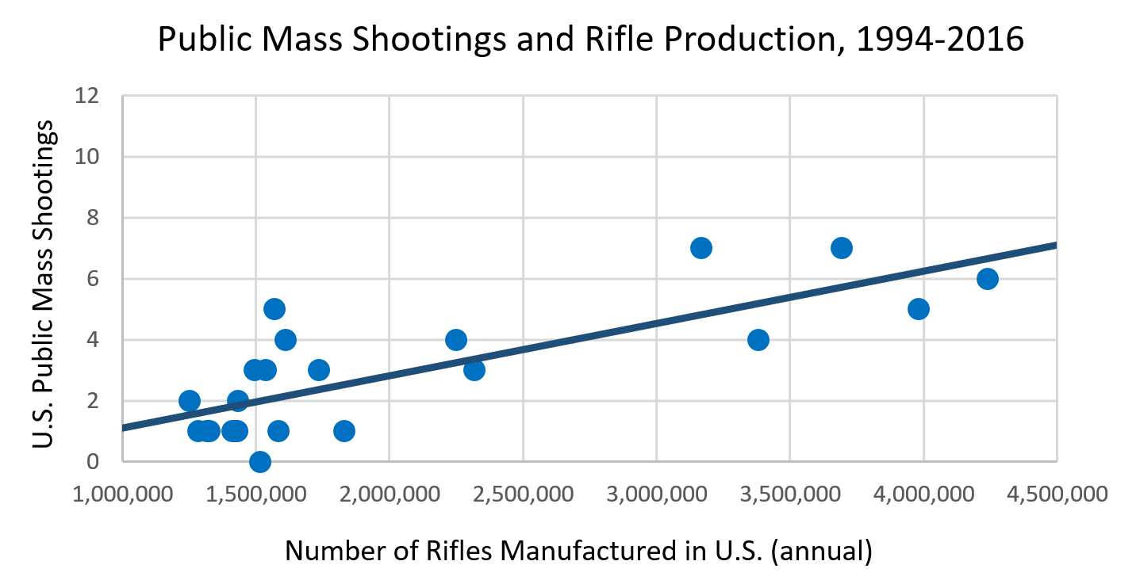
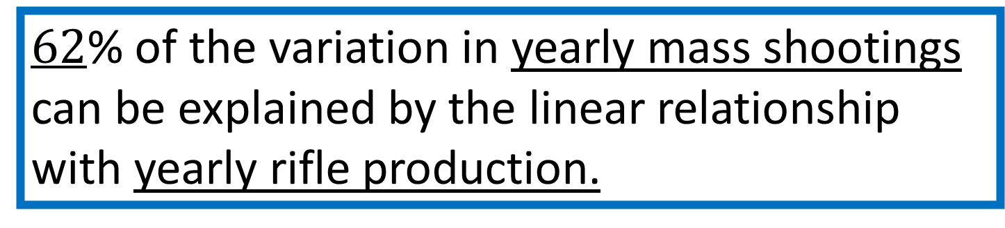
Interpret: r² = 0.62
$62$% of the variation in yearly mass shootings can be explained by the linear relationship with yearly rifle production.

Slide 37
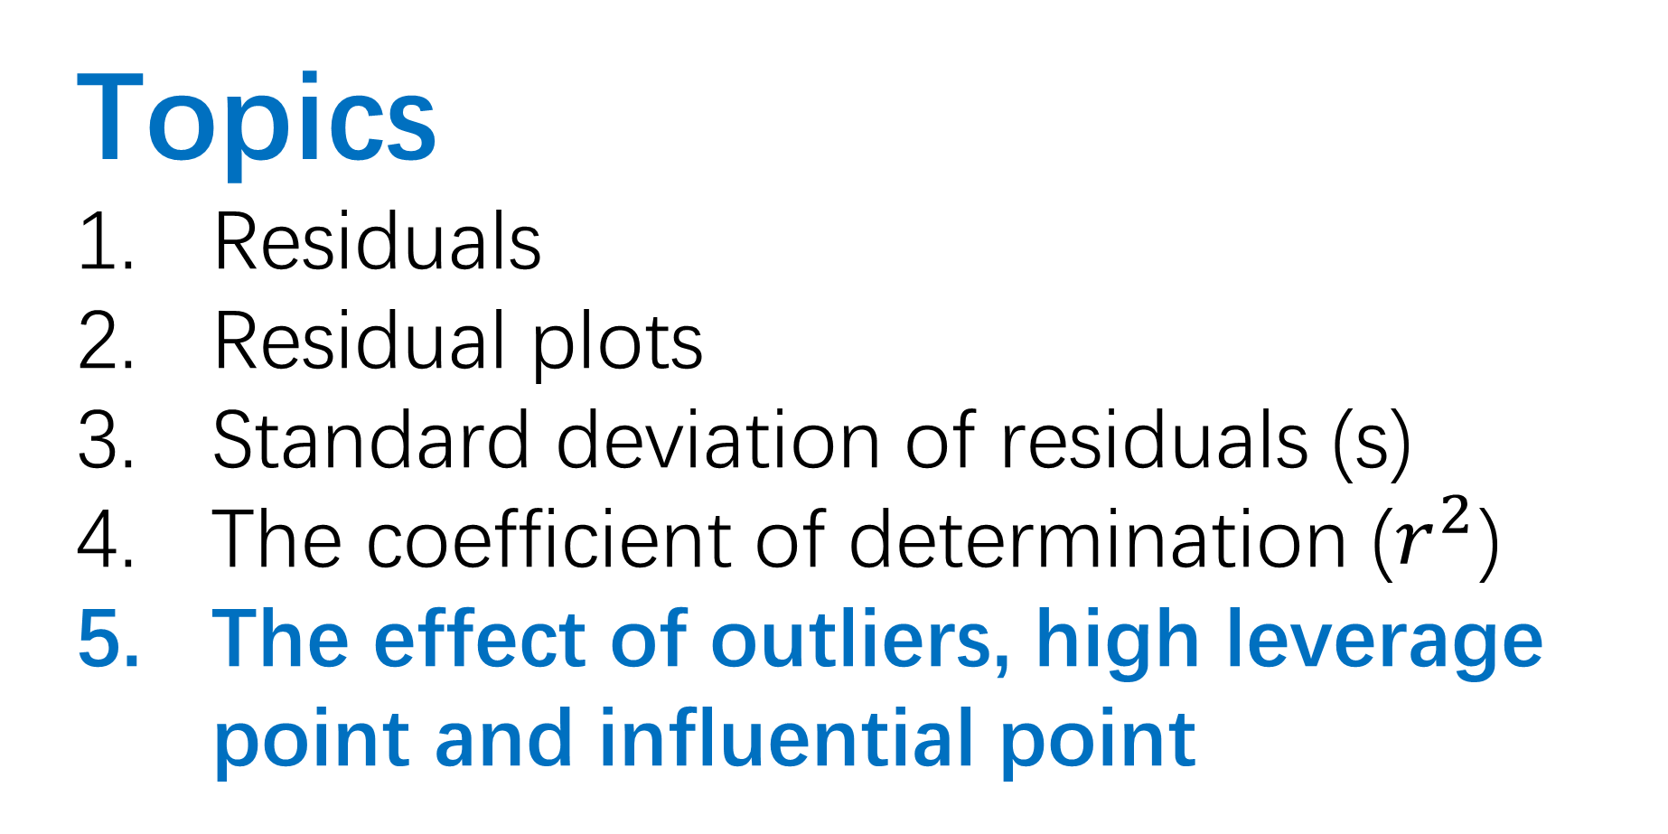
Topics
Residuals
Residual plots
Standard deviation of residuals (s)
The coefficient of determination ($r^{2}$)
The effect of outliers, high leverage point and influential point

Slide 38
An outlier is a data point whose response y does not follow the general trend of the rest of the data.
A data point has high leverage if it has "extreme" predictor x values.
A data point is influential if it influences any part of a regression analysis, e.g. value of the slope.

Slide 39
What is an outlier in a regression model?
An outlier is a data point whose response y does not follow the general trend of the rest of the data.

Slide 40
What is an outlier in a regression model?
Not an outlier! Even though far away from other points, it is still close to our linear model.

Slide 41
What is an outlier in a regression model?
Not an outlier! Even though far away from other points, it is still close to our linear model.
It is an outlier! The point is unusually far from the regression line compared to the other points

Slide 42
What is an outlier in a regression model?

Slide 43
What is an outlier in a regression model?
Not an outlier! Even though far away from the LSRL, it is not unusually far from the LSRL. Most data points vary a lot from the LSRL.

Slide 44
Data from 1994-2016

Slide 45
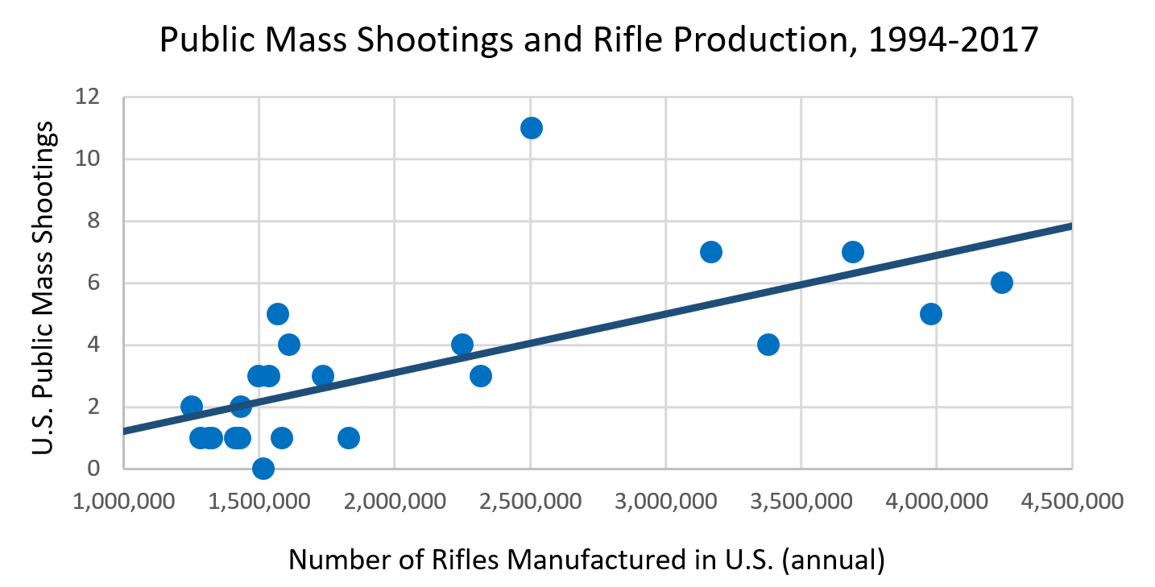
Data from 1994-2017

Slide 46
Data from 1994-2017
Outlier
2017
A data value unusually far away from the LSRL (unusually large residual)

Slide 47
Data from 1994-2016
r = 0.79

Slide 48
Data from 1994-2017
r = 0.67

Slide 49
Data from 1994-2016
r² = 0.62

Slide 50
Data from 1994-2017
r² = 0.45

Slide 51
Data from 1994-2016
s = 1.31

Slide 52
Data from 1994-2017
s = 1.98

Slide 53
r, r², and s are not resistant to outliers.
Outliers lower the strength of a relationship, making…
r smaller (magnitude)
r² smaller
s larger

Slide 54
outlier
influential point
high leverage point

Slide 55
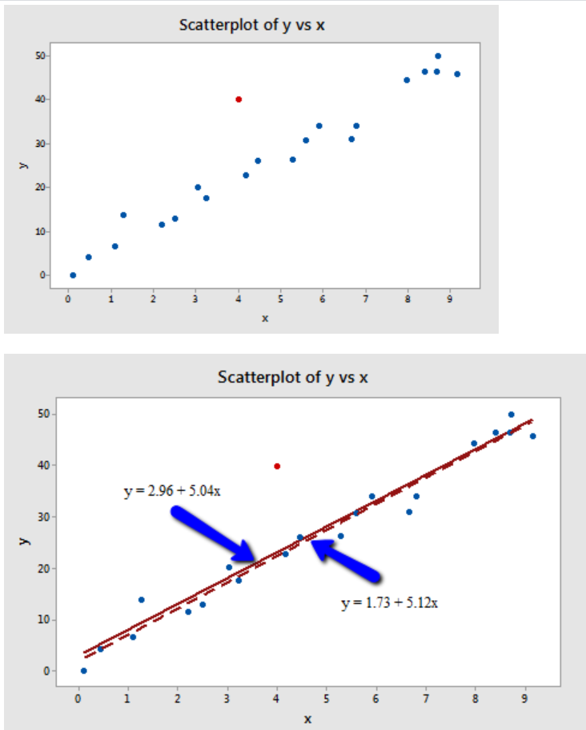
The red data point does not follow the general trend of the rest of the data, it would be considered an outlier.
However, this point does not have an extreme x value, so it does not have high leverage.
Is the red data point influential? An easy way to determine if the data point is influential is to find the best fitting line twice — once with the red data point included and once with the red data point excluded.

Slide 56
It's hard to even tell the two estimated regression equations apart!
The solid line represents the estimated regression equation with the red data point included,
while the dashed line represents the estimated regression equation with the red data point taken excluded.
The slopes of the two lines are very similar — 5.04 and 5.12, respectively.

Slide 57
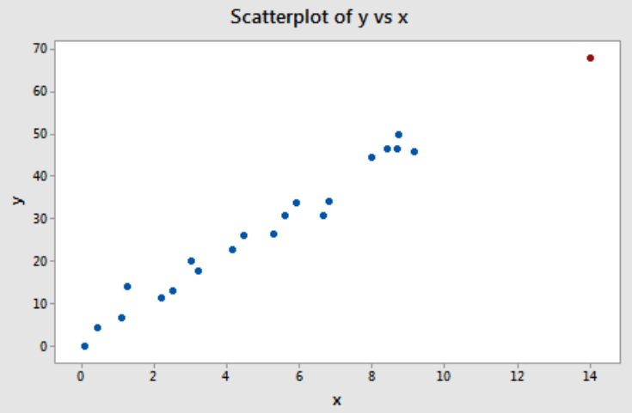
The red data point does follow the general trend of the rest of the data.
Therefore, there are no outliers.
However, this point does have an extreme x value, so it does have high leverage.
Is the red data point influential?

Slide 58
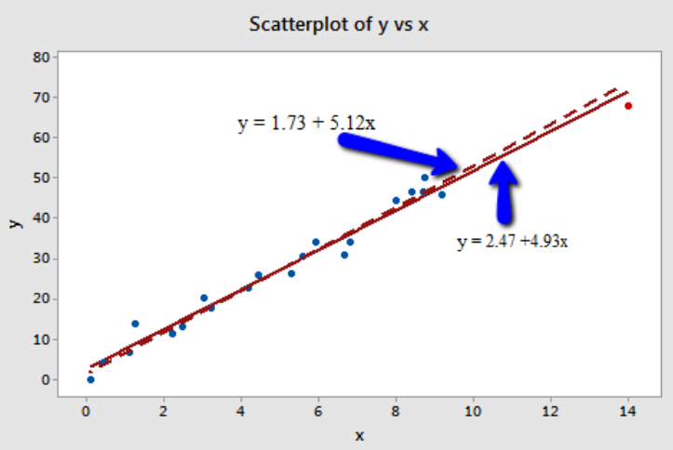
Again, it's hard to even tell the two estimated regression equations apart!
The slopes of the two lines are very similar — 4.927 and 5.117, respectively.

Slide 59
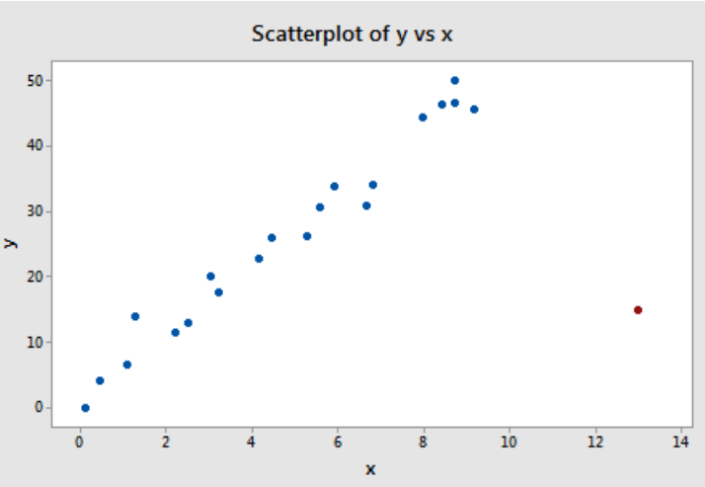
The red data point is most certainly an outlier (the red data point does not follow the general trend of the rest of the data)
and has high leverage (and it also has an extreme x value).
Is the red data point influential?

Slide 60
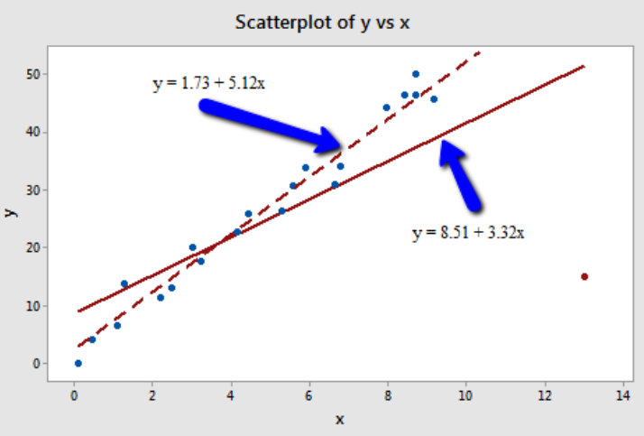
In this case, the red data point is influential.
The two best fitting lines are quite different!
The existence of the red data point significantly reduces the slope of the regression line — dropping it from 5.117 to 3.320.

